Slide 1
STORY TELLING WITH DATA
PRACTICAL – 5
Storyboard – Imported student_data.csv file. The data visualizes how each program differs with different measures of values of data.

Slide 2
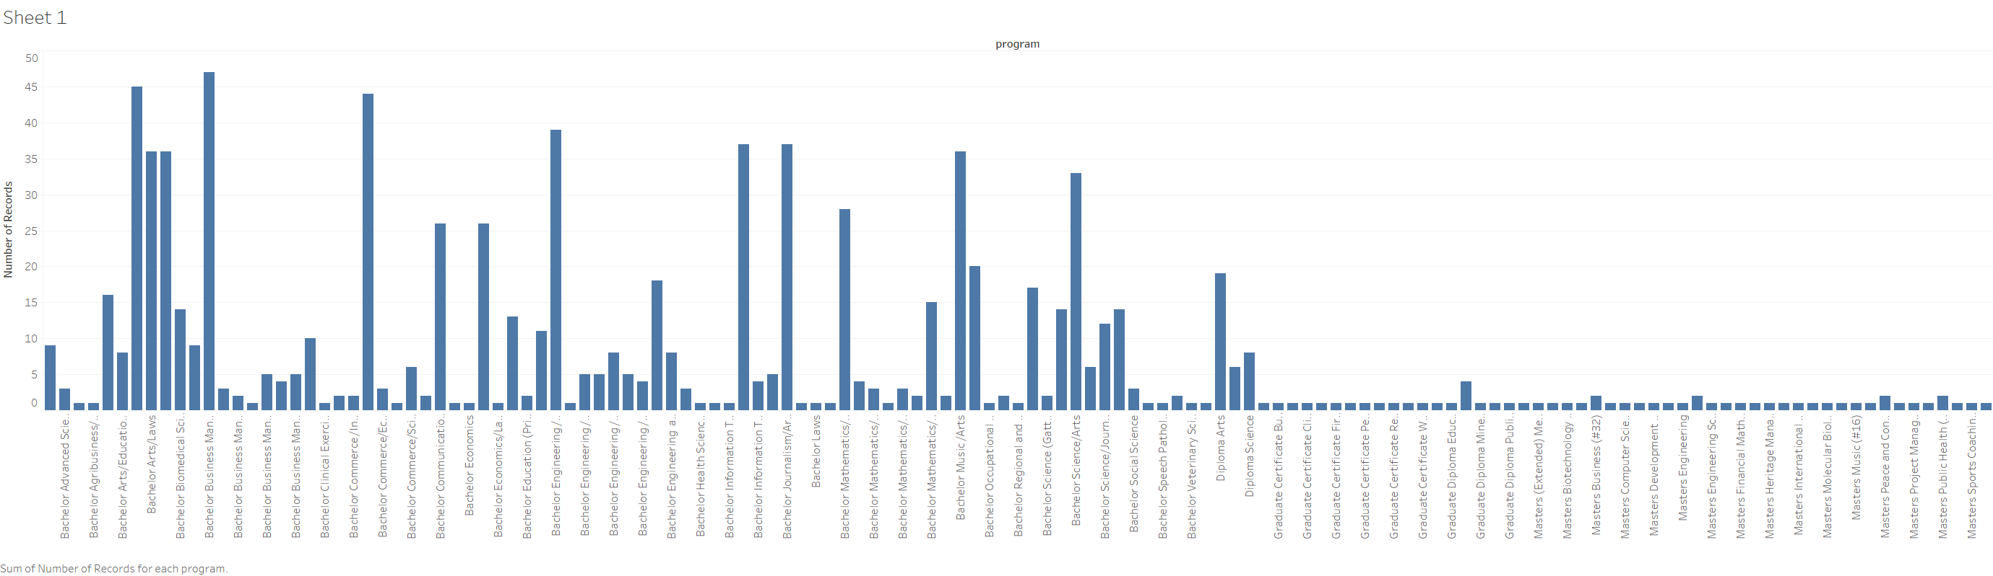
Sum of Number of Records for each Program
Notes:
Conclusion from the visualization of data : The program for Bachelor of Business Management has the highest sum of number of records.

Slide 3
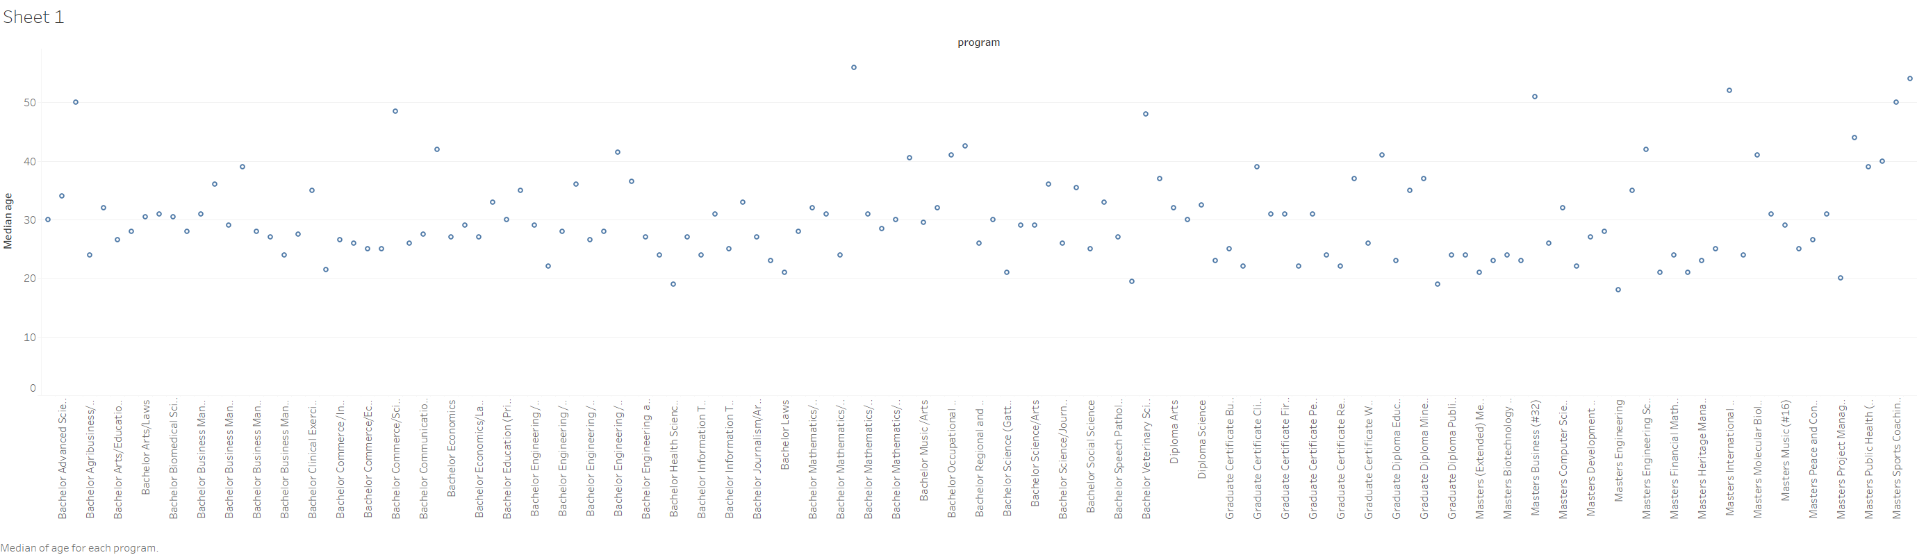
Median Age for each program
Notes:
Conclusion from the visualization of data : The median age for almost every program lies from 20 to 40.

Slide 4
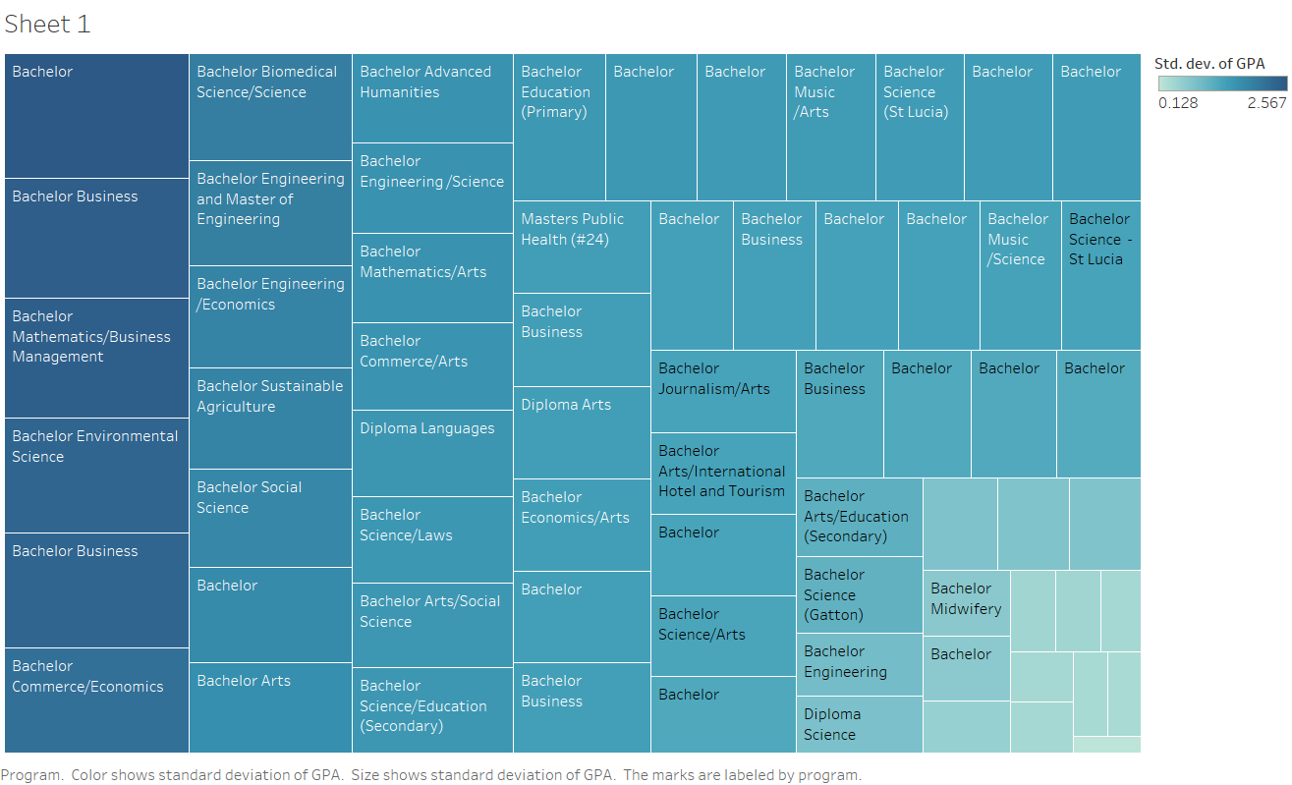
Program color shows the standard deviation of GPA and the size shows the standard deviation of GPA. The marks are labeled by program.
Notes:
The data conveys the Standard deviation of GPA for each program. According to the data visualized, the standard deviation are more concentrated towards the mean of the GPA.

